Slide 1
MANAGEMENT INFORMATION SYSTEM(MIS)

Slide 2
What is MIS?
MIS stands for management Information System.
Management information system, or MIS, broadly refers to a computer-based system that provides managers with the tools to organize, evaluate and efficiently manage departments within an organization.
In order to provide past, present and prediction information, a management information system can include software that helps in decision making, data resources such as database , the hardware resources of a system, decision support system, people management and project management applications, and any computerized processes that enable the department to run efficiently.
MIS professionals are technically proficient and focus on business process and information technology. They try to maximize the benefits from investment. They can choose the following career options:
IT consultants
Business Analysts
System Analyst
Business Intelligence Analyst
Business Application Developer
System Developer
Information System Manager etc.

Slide 3
Advantages of MIS
MIS can provide following benefits:
Identify the strengths and weaknesses of companies.
Work as a planning tool.
Provide all over picture of the company.
Collect and analyze information of customers for future references.
Work as a planning and communication tool.

Slide 4
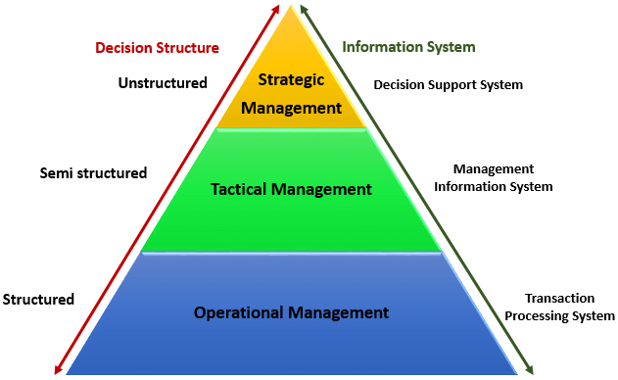
Pyramid Diagram of Organizational levels

Slide 5
Contd…
Operational management level: The operational level is concerned with performing day to day business transactions of the organization.
Examples of users at this level of management include cashiers at a point of sale, bank tellers, nurses in a hospital, customer care staff, etc.
Tactical Management Level: This organization level is dominated by middle-level managers, heads of departments, supervisors, etc. The users at this level usually oversee the activities of the users at the operational management level.
Strategic Management Level: This is the most senior level in an organization. The users at this level make unstructured decisions. Senior level managers are concerned with the long-term planning of the organization. They use information from tactical managers and external data to guide them when making unstructured decisions.

Slide 6
Contnd…
Transaction Processing System (TPS): A transaction process system (TPS) is an information processing system for business transactions involving the collection, modification and retrieval of all transaction data. Characteristics of a TPS include performance, reliability and consistency. TPS is also known as transaction processing or real-time processing.
Decision Support Systems: Decision Support Systems (DSS) are interactive computer-based systems that enable people to use IT communications, data, documents, knowledge and models to solve problems and make decisions. DSS are intended to improve and speed-up the processes by which people make and communicate decisions. However, they are designed to be auxiliary systems instead of replacing skilled decision makers.

